Slide 1
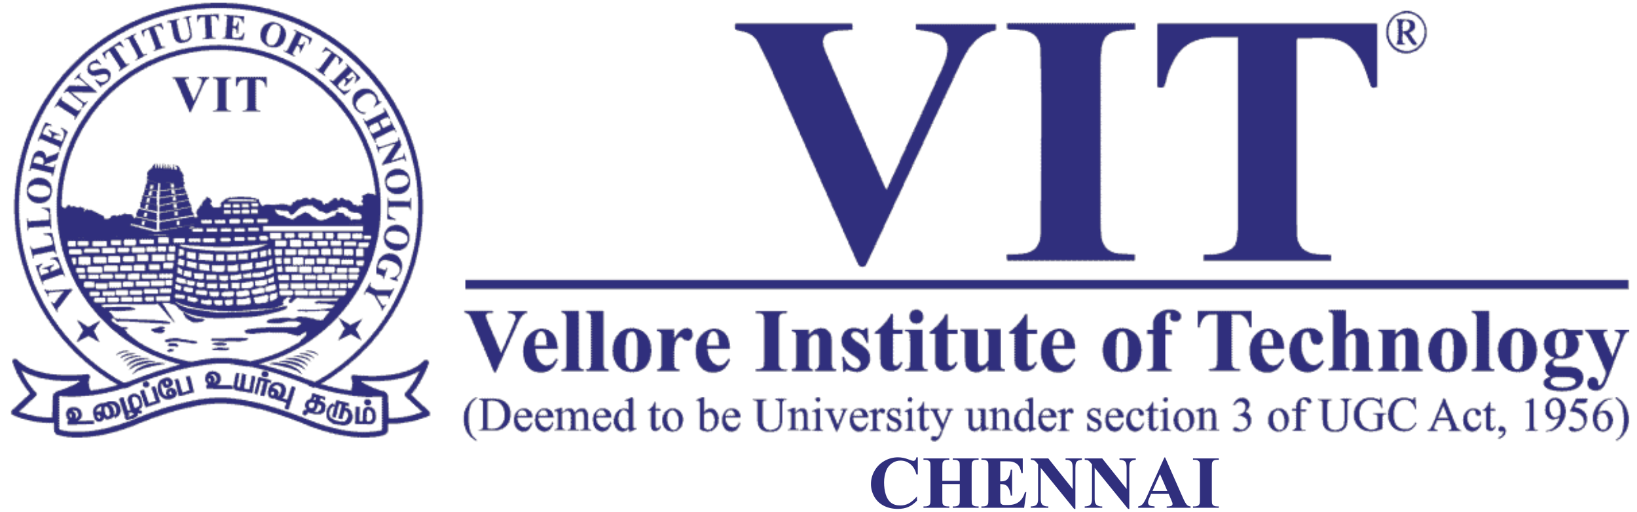
GAN
Dr. David Raj M
Assistant Professor & Assistant Director, RAAC
School of Advanced Sciences
Vellore Institute of Technology, Chennai

Slide 2
GANs are about creating, like drawing a portrait or composing a symphony, which is far more challenging than many other deep learning tasks.

Slide 3

What GAN do?
The primary focus of GANs (Generative Adversarial Networks) is to generate data from scratch, most notably images, though applications in other domains such as music, text, and video have also been explored.
For instance, GANs can perform image-to-image translation, such as transforming a horse into a zebra.

Slide 4
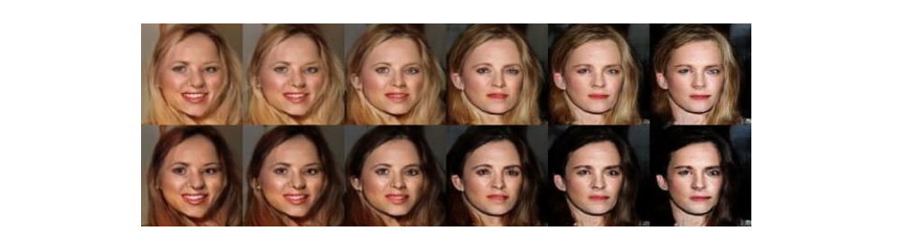
Converting Black to Blonde hair
Images produced in CoGAN

Slide 5
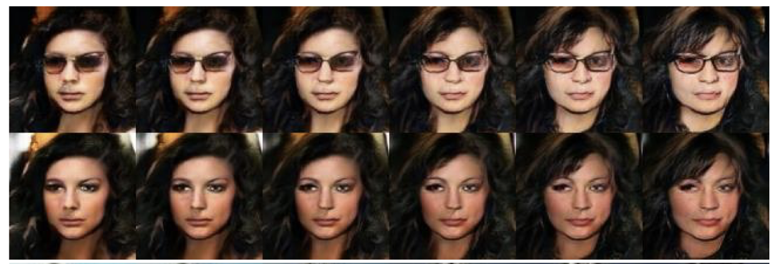
Eye Glasses

Slide 6
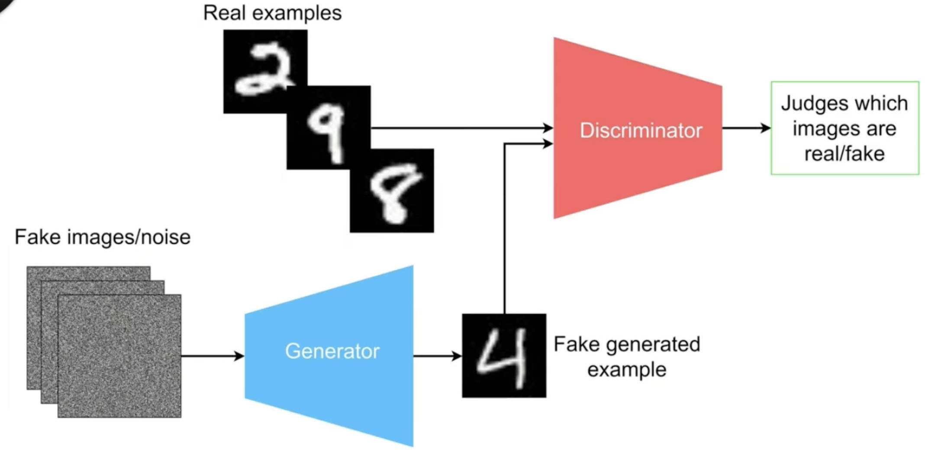

Slide 7
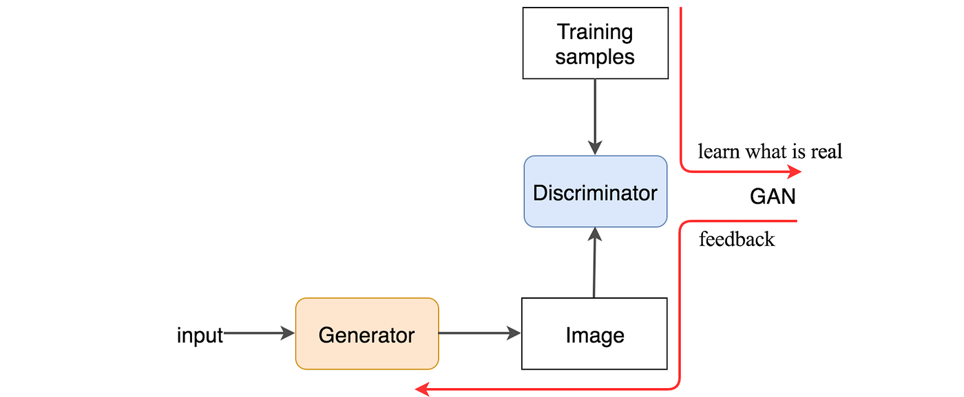

Slide 8
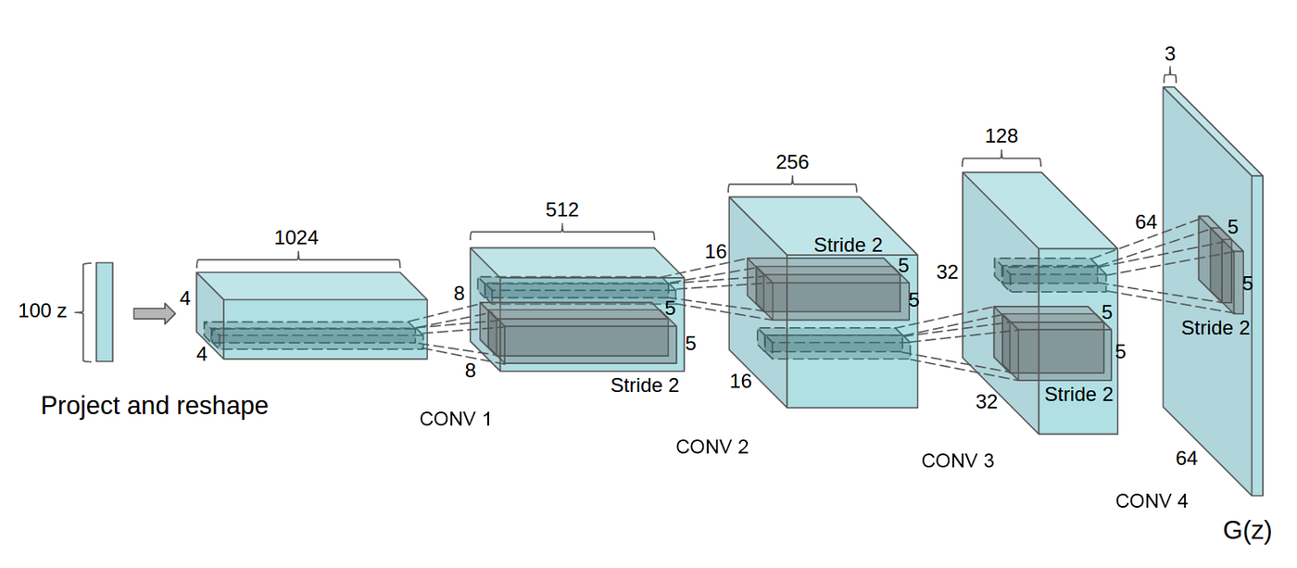
Generator and discriminator
GANs consist of two neural networks: a generator and a discriminator.

Slide 9
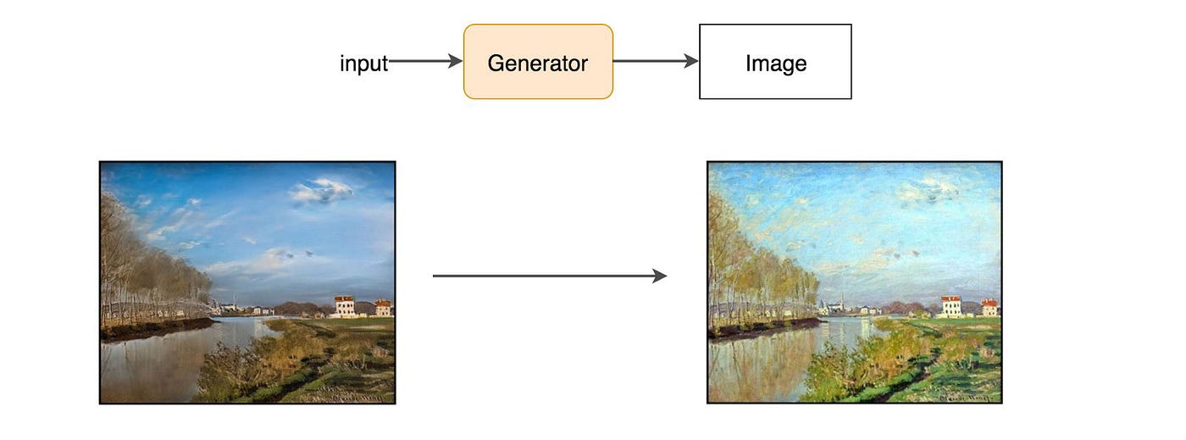
Generator

Slide 10

Discriminator

Slide 11
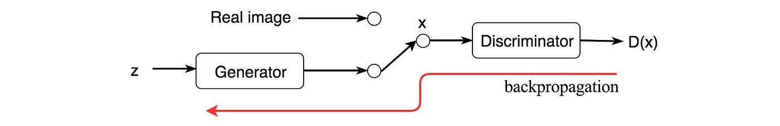

Slide 12
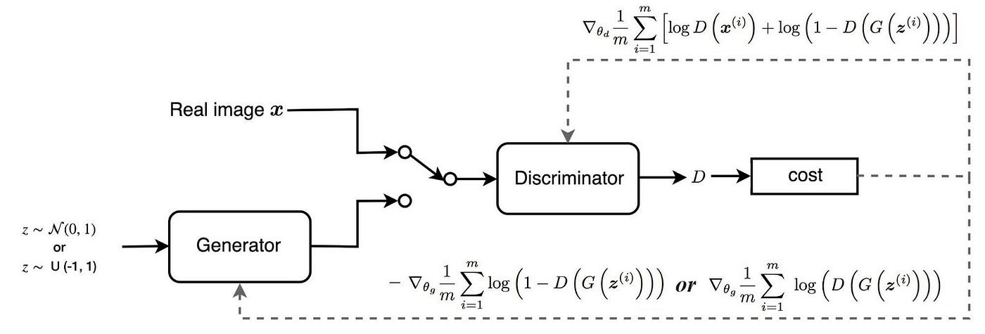

Slide 13
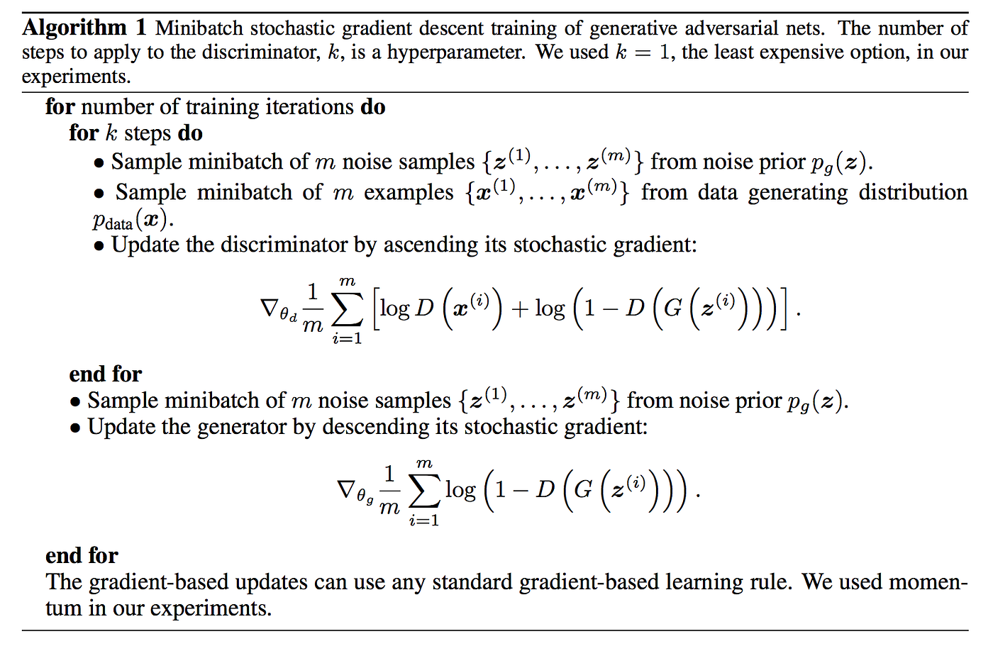
Full Process of GAN

